Slide 1

Human Computer Interaction
Hi-Fi Prototype
Presented By:
Lim Boon Hian (U2120791F)

Slide 2
Tutorial
Go Through Tutorial?
Yes
No

Slide 3

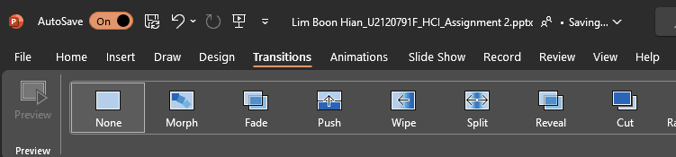
0. Powerpoint Tutorial
Compatibility Check
This PowerPoint slides use Morph transition for most of the animations, you can check if you have the transition in your PowerPoint in Transitions Tab.
If your PowerPoint does not support it, please go to the following link to access the prototype.
Lim Boon Hian_U2120791F_HCI_Assignment 2.pptx

Slide 4




0. Powerpoint Tutorial
Buttons
While going through the slides, please only use mouse click for the best experience.
Please do not use the keyboard and mouse scroll as it may cause confusion, unless you understand the flow.

Slide 5



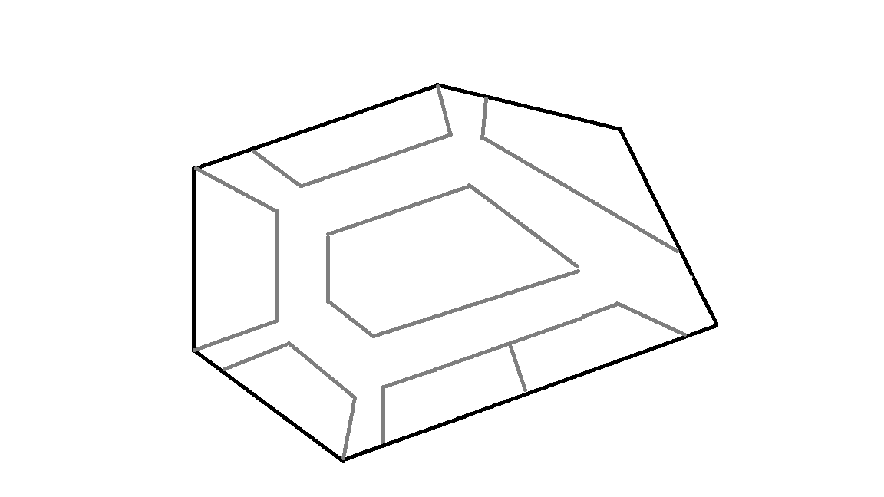
Phone Screen
Popular
FairPrice
0. Powerpoint Tutorial
Introduction
L1
The typical layout for the slides will look like this:
Shack Shake
Waterfall
Starbucks
KFC
McDonald
F
Config Menu
Where to?

Slide 6
Phone Screen
Popular
FairPrice
0. Powerpoint Tutorial
Introduction
L1
Phone screen just display the prototype.
Shack Shake
Waterfall
Starbucks
KFC
McDonald
F
Where to?

Slide 7
0. Powerpoint Tutorial
Introduction
Config menu consist of 5 buttons which does different jobs.
Back to Type Overview(Clickable Page)
Return to the last viewed page.
Last Features
Go back to overview
Next Features

Slide 8

0. Powerpoint Tutorial
Introduction
You may also encounter such buttons:
For these buttons, you may click either the icon or text “Swipe Left” to
access the feature!
Click the following gestures:
Swipe Left
Swipe Right
Gesture Buttons
Pinch In

Slide 9

Popular
FairPrice
0. Powerpoint Tutorial
Introduction
L1
Let’s try an example. Click one of the gesture to continue.
Shack Shake
Waterfall
Click the following gestures:
Starbucks
Swipe Left
KFC
McDonald
Swipe Right
F
Where to?

Slide 10
Popular
FairPrice
0. Powerpoint Tutorial
Introduction
L1
Congrats! This is exactly how you do so!
Click anywhere to continue,
Shack Shake
Waterfall
Or click here to restart the tutorial.
Starbucks
KFC
McDonald
F
Where to?

Slide 11
Popular
FairPrice
0. Powerpoint Tutorial
Introduction
L1
Congrats! This is exactly how you do so!
Click anywhere to continue,
Shack Shake
Waterfall
Or click here to restart the tutorial.
Starbucks
KFC
McDonald
F
Where to?

Slide 12
Popular
FairPrice
0. Powerpoint Tutorial
Introduction
Multi-level button
L1
In the slides, usually only the item that is pointed can be clicked.
Shack Shake
Waterfall
Let’s try an example. Click the item that is pointed to continue.
Starbucks
KFC
McDonald
F
Where to?

Slide 13
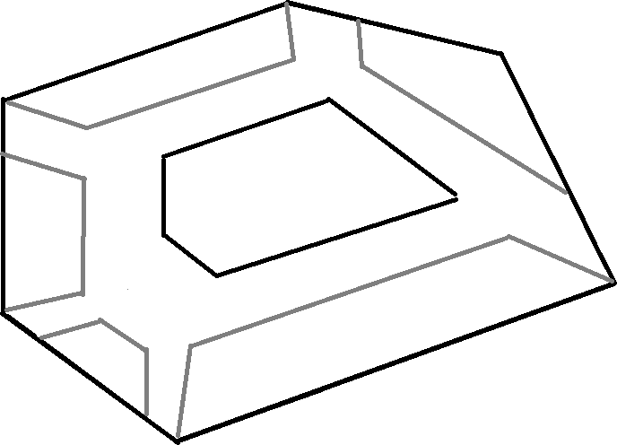
0. Powerpoint Tutorial
Introduction
L2
Books Kinokuniya
A&W
Boost
Congrats! This is exactly how you do so!
Kopitiam
Click anywhere to continue,
LiHO!
Or click here to restart the tutorial.
L1
Popular
FairPrice
Shack Shake
Waterfall
KFC
Starbucks
McDonald
F
Where to?

Slide 14
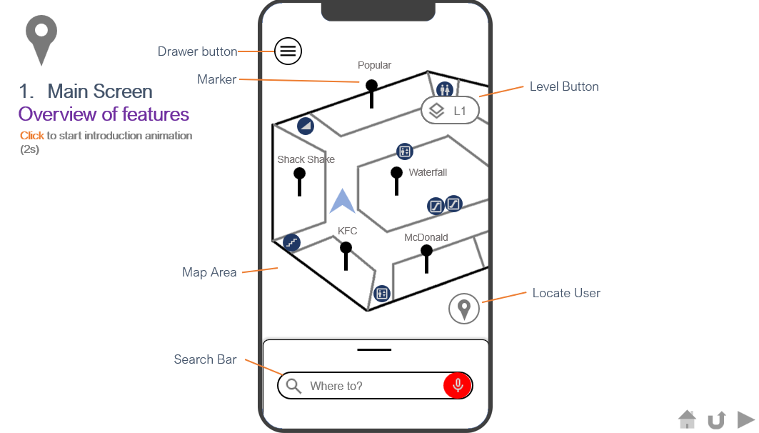
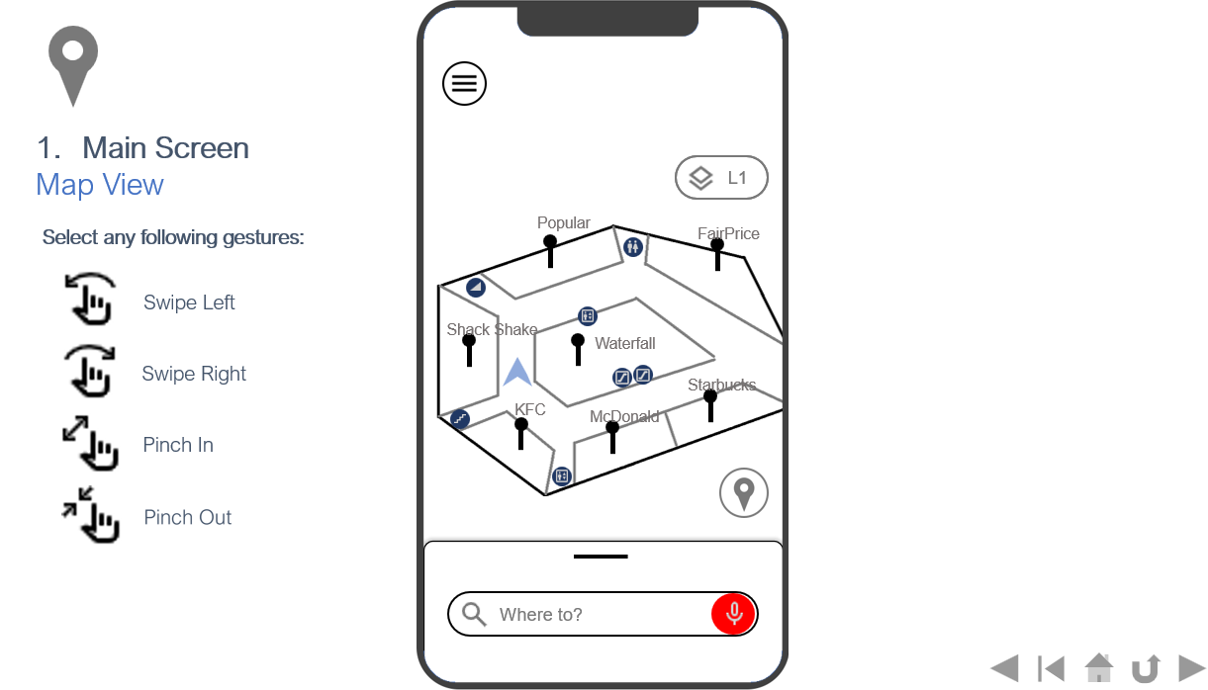
0. Powerpoint Tutorial
Introduction
There are two types of slides (Type Overview / Type Specific):
On the other hand, most button in Type Specific will NOT be clickable, except explicitly mentioned (pointed).
Most, if not everything, on the Type Overview are clickable.
You can distinguish between them checking the subtitle:
Type Overview
Type Specific

Slide 15
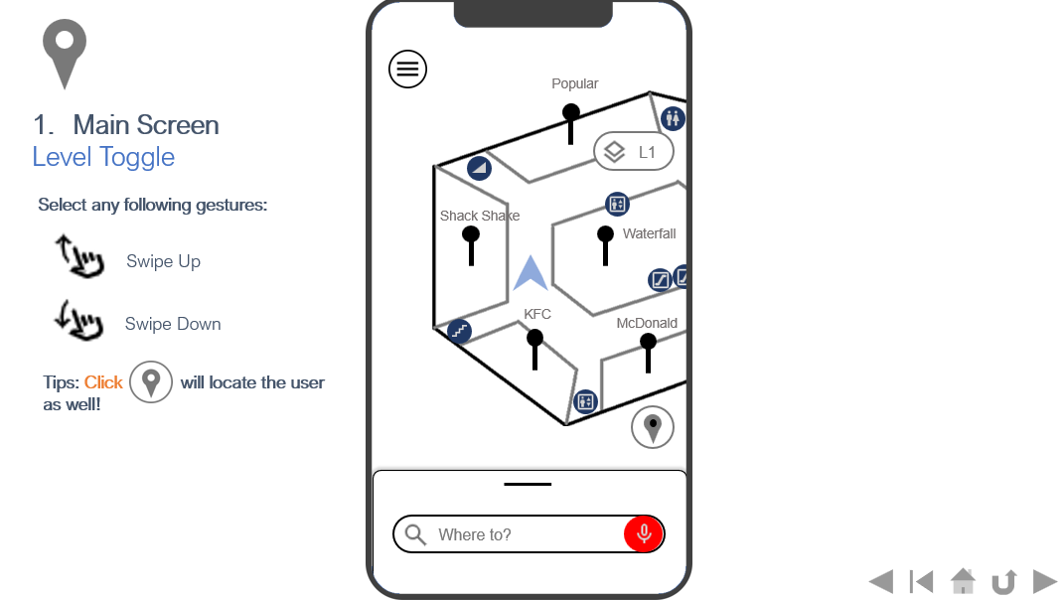
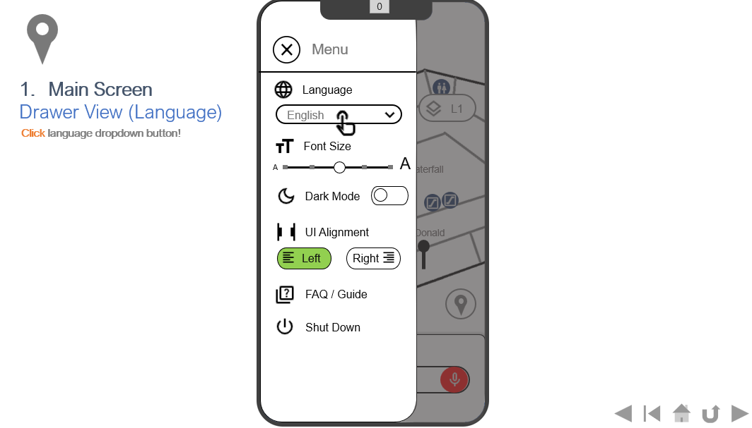
0. Powerpoint Tutorial
Introduction
There is two ways to go through the slides:
Type 1: Go through the slides as if the pages are not clickable
Type Overview
Type Specific # 1
Type Specific # 2
Type Specific # 3
Type 2:Go through the slides by returning to type overview
Press to go back to Type Overview Slide
Type Overview
Type Specific # 1
Type Overview
Type Specific # 2

Slide 16
Without further ado, let’s get started!
Click anywhere to start.
Or click here to restart the tutorial.

Slide 17
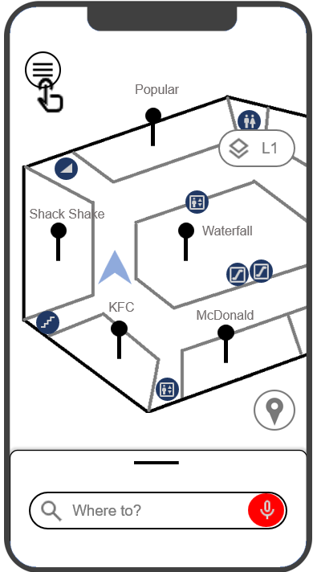
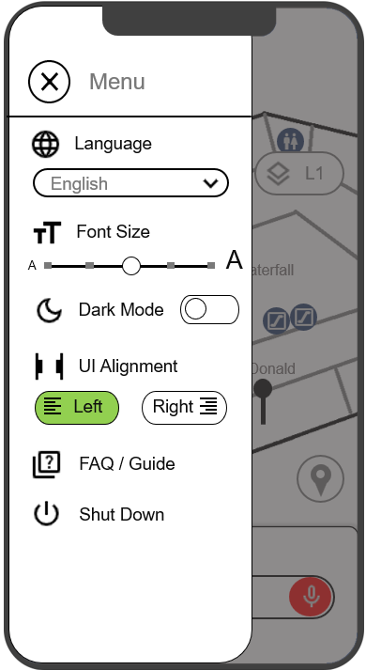
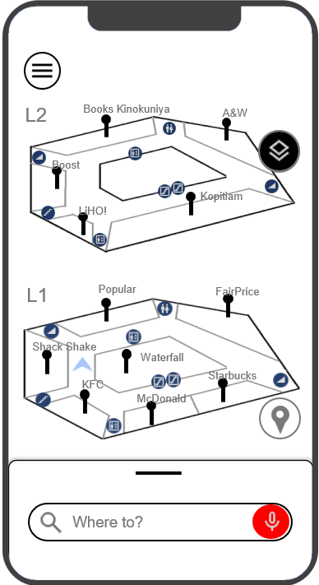
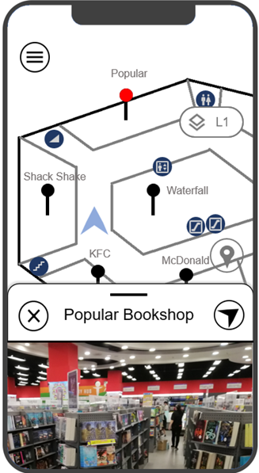
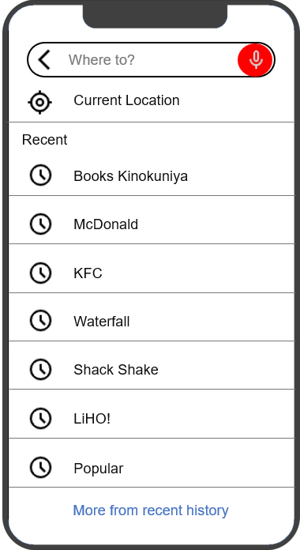
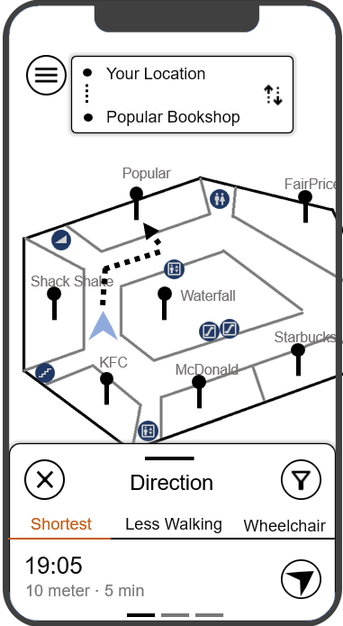
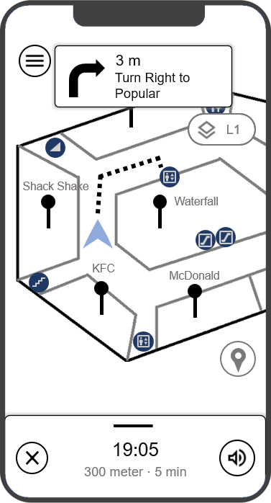
Overview
Main Screen
Drawer Screen
Multi-level Map Screen
Details Screen

Slide 18

Overview
Details Screen
Search Screen
Direction Screen
Navigation Screen

Slide 19
Drawer button
Popular
Marker
FairPrice
Main Screen
Overview of features
Level Button
L1
Click to start introduction animation (2s)
Shack Shake
Waterfall
Starbucks
KFC
McDonald
Map Area
Locate User
Search Bar
F
Where to?

Slide 20
Popular
FairPrice
Main Screen
Overview of features
L1
Shack Shake
Waterfall
Starbucks
KFC
McDonald
F
Where to?

Slide 21
Drawer button
Popular
Marker
FairPrice
Main Screen
Overview of features
Level Button
L1
Click any features to explore that certain features; or
Click anywhere else to follow the tutorial flow
Click to start introduction animation (2s)
Shack Shake
Waterfall
Starbucks
KFC
McDonald
Map Area
Locate User
Search Bar
F
Where to?

Slide 22
Main Screen
Map View
L1
Click the following gestures:
Popular
FairPrice
Swipe Left
Shack Shake
Waterfall
Swipe Right
Starbucks
KFC
McDonald
Pinch In
F
Where to?

Slide 23
Popular
FairPrice
Main Screen
Map View
L1
Click the following gestures:
Shack Shake
Waterfall
Swipe Left
Starbucks
Swipe Right
KFC
McDonald
Pinch In
F
Where to?

Slide 24
Popular
FairPrice
Main Screen
Locate User
L1
Oh no! We have lost the user.
Let’s say we are scrolling the map.
Shack Shake
Let’s click to relocate the user.
Waterfall
Starbucks
KFC
McDonald
F
Where to?

Slide 25
Popular
FairPrice
Main Screen
Locate User
L1
Well done! We are now back focusing on the user!
Shack Shake
Waterfall
Starbucks
KFC
McDonald
Note that the icon color changes as well.
F
Where to?

Slide 26
Popular
FairPrice
Main Screen
Level Toggle
L1
Click the following gestures:
Shack Shake
Waterfall
Swipe Up
Starbucks
Swipe Down
KFC
McDonald
Tips: Click will locate the user as well!
F
Where to?

Slide 27
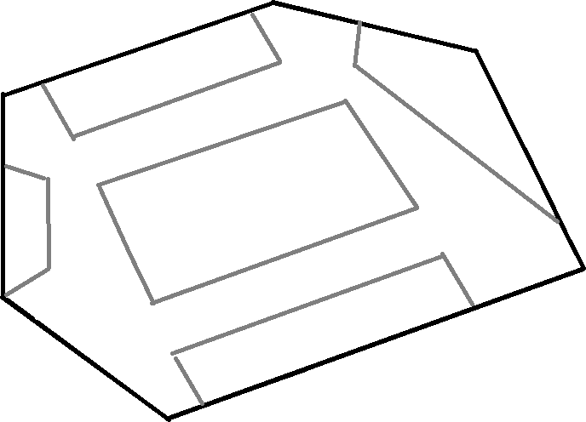
The Better Toy Store
IKEA
Main Screen
Level Toggle
B1
Click the following gestures:
Baskin-Robbins
Game Arcade
Toys”R”Us
Swipe Down
Tips: Click will locate the user as well!
F
Where to?

Slide 28
Popular
FairPrice
Main Screen
Level Toggle
L1
Click the following gestures:
Shack Shake
Waterfall
Swipe Up
Starbucks
Swipe Down
KFC
McDonald
Tips: Click will locate the user as well!
F
Where to?

Slide 29
Books Kinokuniya
A&W
Main Screen
Level Toggle
L2
Click the following gestures:
Boost
Swipe Up
LiHO!
Kopitiam
Tips: Click will locate the user as well!
F
Where to?

Slide 30
Popular
FairPrice
Main Screen
Drawer View
L1
Click drawer button to start
Shack Shake
Waterfall
Starbucks
KFC
McDonald
F
Where to?

Slide 31

Close button
Menu
Popular
FairPrice
Language
Main Screen
Overview of features
Language
English
L1
Click any features to explore that certain features; or
Click anywhere else to follow the tutorial flow
Click to start introduction animation (2s)
Font Size
Font Size
Shack Shake
A
A
Waterfall
Dark Mode
Dark Mode
Starbucks
KFC
UI Alignment
UI Alignment
McDonald
Left
Right
FAQ / Guide
FAQ / Guide
Shut Down
Shut Down
F
Where to?

Slide 32
Menu
Popular
FairPrice
Main Screen
Drawer View (Language)
Language
English
L1
Click language dropdown button!
Font Size
Shack Shake
A
A
Waterfall
Dark Mode
Starbucks
KFC
UI Alignment
McDonald
Left
Right
FAQ / Guide
Shut Down
F
Where to?

Slide 33
Menu
Popular
FairPrice
Main Screen
Drawer View (Language)
Language
English
L1
User can customize their language in the menu.
Chinese (Simplified)
Font Size
Bahasa Melayu
Shack Shake
A
A
தமிழ் மொழி
Waterfall
Click anywhere to continue.
Dark Mode
Starbucks
KFC
UI Alignment
McDonald
Left
Right
FAQ / Guide
Shut Down
F
Where to?

Slide 34
Menu
Popular
FairPrice
Main Screen
Drawer View (Font Size)
Language
English
L1
Select any following gestures:
Font Size
Shack Shake
A
Swipe Left
A
Waterfall
Dark Mode
Starbucks
Swipe Right
KFC
UI Alignment
McDonald
Left
Right
FAQ / Guide
Shut Down
F
Where to?

Slide 35
Menu
Popular
FairPrice
Main Screen
Drawer View (Font Size)
Language
English
L1
Select any following gestures:
Font Size
Shack Shake
A
A
Waterfall
Dark Mode
Starbucks
Swipe Right
KFC
UI Alignment
McDonald
Left
Right
FAQ / Guide
Shut Down
F
Where to?

Slide 36
Menu
Popular
FairPrice
Main Screen
Drawer View (Font Size)
Language
English
L1
Select any following gestures:
Font Size
Shack Shake
A
Swipe Left
A
Waterfall
Dark Mode
Starbucks
Swipe Right
KFC
UI Alignment
McDonald
Left
Right
FAQ / Guide
Shut Down
F
Where to?

Slide 37
Menu
Popular
FairPrice
Main Screen
Drawer View (Font Size)
Language
English
L1
Select any following gestures:
Font Size
Shack Shake
A
Swipe Left
A
Waterfall
Dark Mode
Starbucks
KFC
UI Alignment
McDonald
Left
Right
FAQ / Guide
Shut Down
F
Where to?

Slide 38
Menu
Popular
FairPrice
Main Screen
Drawer View (Dark Mode)
Language
English
L1
Click dark mode button to toggle dark mode / light mode
Font Size
Shack Shake
A
A
Waterfall
Dark Mode
Starbucks
KFC
UI Alignment
McDonald
Left
Right
FAQ / Guide
Shut Down
F
Where to?

Slide 39
Menu
Popular
FairPrice
Main Screen
Drawer View (Dark Mode)
Language
English
L1
Click dark mode button to toggle dark mode / light mode
Font Size
Shack Shake
A
A
Waterfall
Dark Mode
Starbucks
KFC
UI Alignment
McDonald
Left
Right
FAQ / Guide
Shut Down
F
Where to?

Slide 40
Menu
Popular
FairPrice
Main Screen
Drawer View (Dark Mode)
Language
English
L1
Click dark mode button to toggle dark mode / light mode
Font Size
Shack Shake
A
A
Waterfall
Dark Mode
Starbucks
KFC
UI Alignment
McDonald
Left
Right
FAQ / Guide
Shut Down
F
Where to?

Slide 41
Menu
Popular
FairPrice
Main Screen
Drawer View (Alignment)
Language
English
L1
Click left / right button to toggle between left / right alignment
L/R
Font Size
Shack Shake
A
A
Waterfall
Dark Mode
Starbucks
KFC
UI Alignment
McDonald
Left
Right
FAQ / Guide
Shut Down
F
Where to?

Slide 42
Menu
Popular
FairPrice
Main Screen
Drawer View (Alignment)
Language
L1
English
Click left / right button to toggle between left / right alignment
L/R
Font Size
Shack Shake
A
A
Waterfall
Dark Mode
Starbucks
KFC
UI Alignment
McDonald
Left
Right
FAQ / Guide
Shut Down
F
Where to?

Slide 43
Menu
Popular
FairPrice
Main Screen
Drawer View (Alignment)
Language
English
L1
Click left / right button to toggle between left / right alignment
L/R
Font Size
Shack Shake
A
A
Waterfall
Dark Mode
Starbucks
KFC
UI Alignment
McDonald
Left
Right
FAQ / Guide
Shut Down
F
Where to?

Slide 44
Popular
FairPrice
2. Multi-level Map Screen
Level Toggle
L1
L1
Click level toggle button !
Shack Shake
Waterfall
Starbucks
KFC
McDonald
F
Where to?

Slide 45
2. Multi-level Map Screen
Overview of features
L2
Books Kinokuniya
A&W
Boost
Here is where the user can select which floor they would like to visit. A high-level view of map is provided to the user.
Kopitiam
Tips:
Click will locate the user as well!
Click to return back to single level map screen
Click the map (L2 / L1 / B1) to look corresponding single level map screen
LiHO!
Click any following gestures:
L1
Popular
FairPrice
Swipe Up
Shack Shake
Waterfall
KFC
Starbucks
McDonald
F
Where to?

Slide 46
2. Multi-level Map Screen
Overview of features
L1
Popular
FairPrice
Shack Shake
Waterfall
Here is where the user can select which floor they would like to visit. A high-level view of map is provided to the user.
Starbucks
Tips:
Click will locate the user as well!
Click to return back to single level map screen
Click the map (L2 / L1 / B1) to look corresponding single level map screen
KFC
McDonald
Click any following gestures:
B1
The Better Toy Store
IKEA
Baskin-Robbins
Game Arcade
Toys”R”Us
Swipe Down
F
Where to?

Slide 47
2. Multi-level Map Screen
Overview of features
L2
Books Kinokuniya
A&W
Boost
Here is where the user can select which floor they would like to visit. A high-level view of map is provided to the user.
Kopitiam
Tips:
Click will locate the user as well!
Click to return back to single level map screen
Click the map (L2 / L1 / B1) to look corresponding single level map screen
LiHO!
Click any following gestures:
L1
Popular
FairPrice
Swipe Up
Shack Shake
Waterfall
KFC
Starbucks
McDonald
F
Where to?

Slide 48
The Better Toy Store
IKEA
2. Multi-level Map Screen
Back to level-view
B1
Yes, you can click the floor screenshot to look into that specific floor.
Click to return to the multi-level map screen!
Baskin-Robbins
Game Arcade
B1
Toys”R”Us
F
Where to?

Slide 49
Popular
FairPrice
2. Multi-level Map Screen
Back to level-view
L1
Yes, you can click the floor screenshot to look into that specific floor.
Click to return to the multi-level map screen!
Shack Shake
Waterfall
L1
Starbucks
KFC
McDonald
F
Where to?

Slide 50
Books Kinokuniya
A&W
2. Multi-level Map Screen
Back to level-view
L2
Yes, you can click the floor screenshot to look into that specific floor.
Click to return to the multi-level map screen!
Boost
L2
LiHO!
Kopitiam
F
Where to?

Slide 51
Popular
Popular
FairPrice
3. Details Screen
Popular (Bookshop) Demo
L1
When the user long press a marker, a details screen will show up.
Shack Shake
Waterfall
Let’s click Popular for example.
Starbucks
KFC
McDonald
F
Where to?

Slide 52

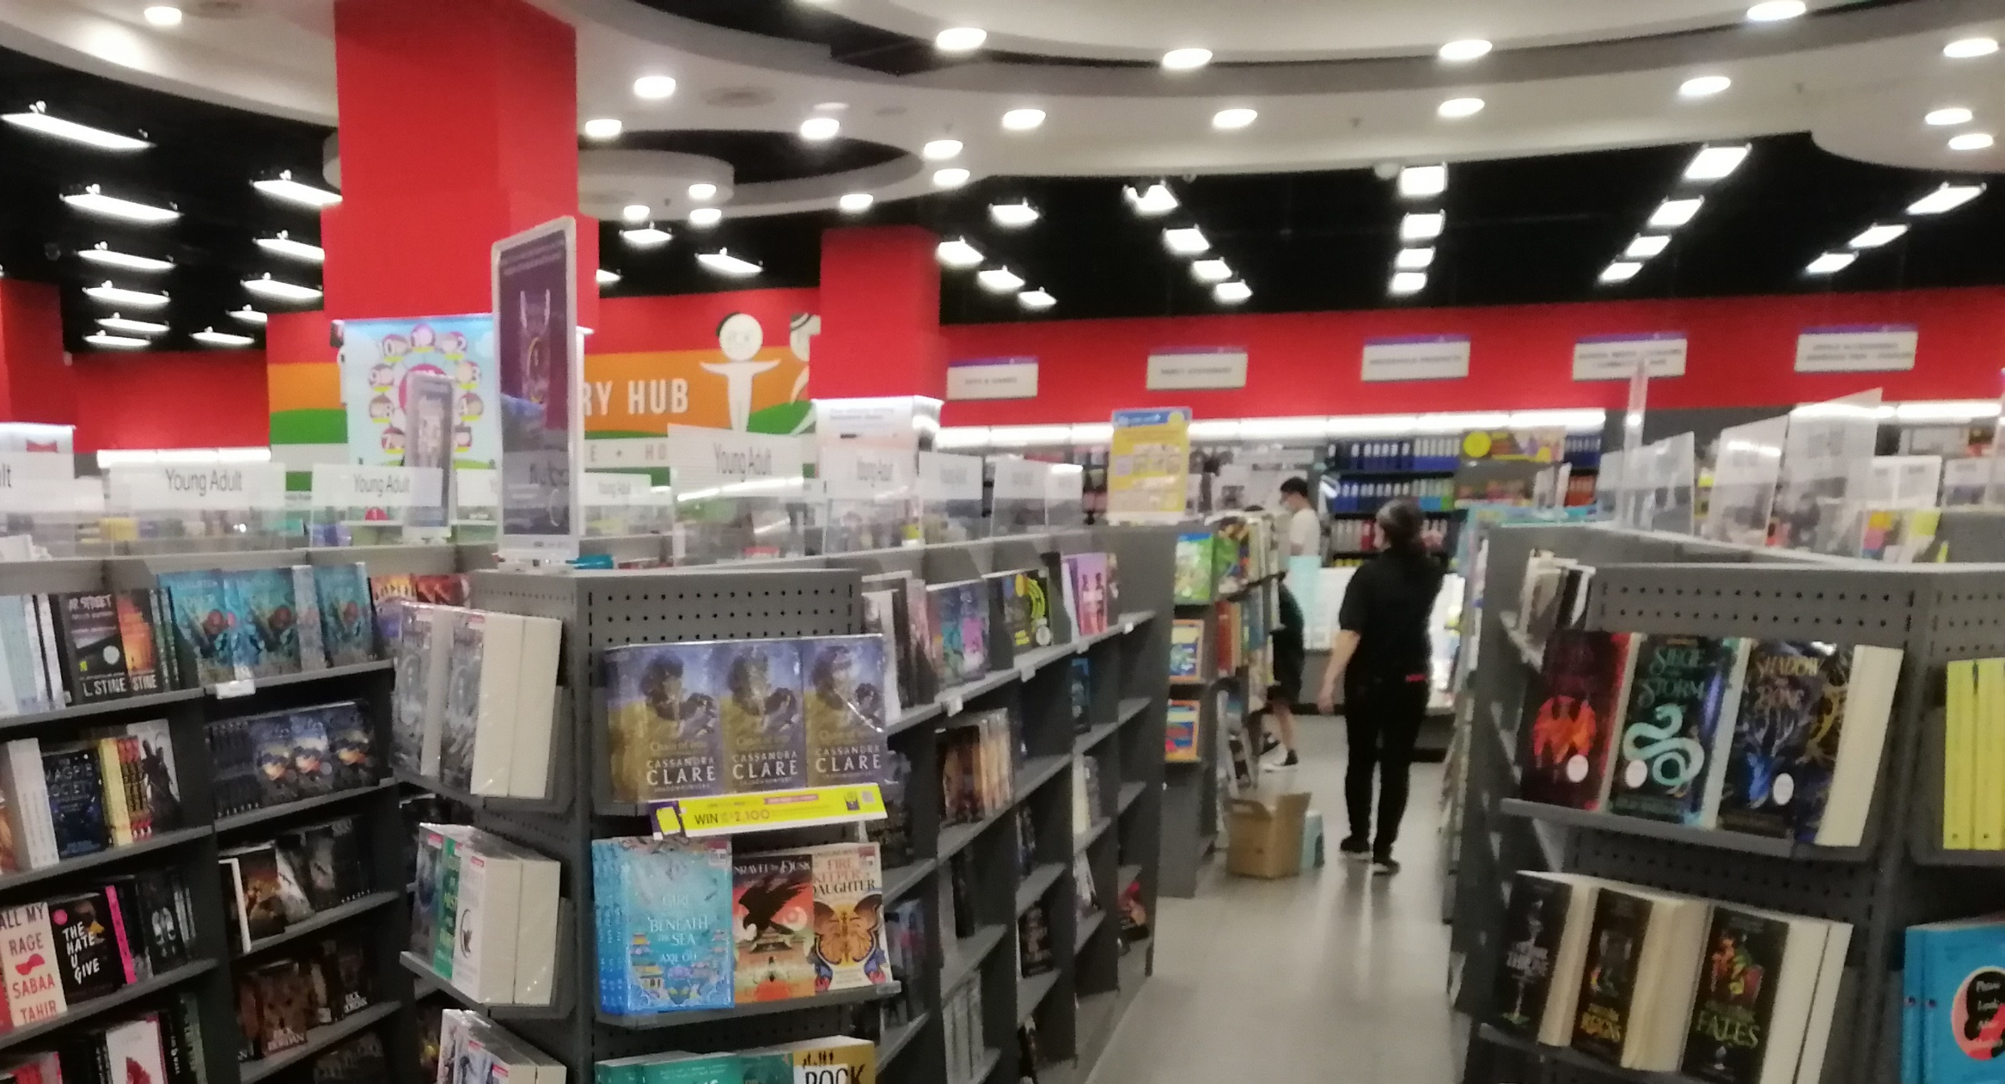
Popular
FairPrice
3. Details Screen
Popular (Bookshop) Demo
L1
Now the shop (Popular) is selected, the basic information of the shop is now listed.
Shack Shake
Waterfall
Click any following gestures:
Starbucks
Swipe Up
KFC
McDonald
Swipe Down
F
Popular Bookshop

Slide 53
Popular
FairPrice
3. Details Screen
Popular (Bookshop) Demo
L1
Now the shop (Popular) is selected, the basic information of the shop is now listed.
Shack Shake
Waterfall
Click any following gestures:
Starbucks
Swipe Up
KFC
McDonald
F
Popular Bookshop

Slide 54
Popular
FairPrice
3. Details Screen
Popular (Bookshop) Demo
L1
Now the shop (Popular) is selected, the basic information of the shop is now listed.
Shack Shake
Waterfall
Click any following gestures:
Starbucks
Swipe Up
KFC
McDonald
Swipe Down
F
Popular Bookshop

Slide 55
F
Popular Bookshop
Popular
FairPrice
3. Details Screen
Popular (Bookshop) Demo
L1
Now the shop (Popular) is selected, the basic information of the shop is now listed.
Shack Shake
Waterfall
Click any following gestures:
Starbucks
Location:
KFC
Jurong Point, #B1-41
McDonald
Opening
Hours:
Opening Now
This can be one of the following:
Swipe Down
Mon: 9:30am – 9:30pm
Opening Soon : 1 hour before opening.
Opening Now : Opening Now
Closing Soon : 1 hour before closing.
Closed : Closed.
Tue: Closed
Wed: 9:30am – 9:30pm
Thu: 9:30am – 9:30pm
Fri: 9:30am – 9:30pm
Sat: 9:00am – 9:30pm
Sun: 9:00am – 9:30pm
Contact
Number:
8600 1234

Slide 56
Popular
FairPrice
4. Search Screen
Introduction
L1
Click the search bar to start the introduction!
Shack Shake
Waterfall
Or, you can click the following gestures to navigate to search screen:
Starbucks
Swipe Up
KFC
McDonald
F
Where to?

Slide 57
F
Search Bar
Return button
Where to?
Mic Button
4. Search Screen
Overview of features
Current Location
Recent
Current Location
Click any features to explore that certain features; or
Click anywhere else to follow the tutorial flow
Click to start introduction animation (2s)
Books Kinokuniya
McDonald
In the real application, all history record will be clickable.
KFC
In this demo, you can only click Books Kinokuniya or Popular for direction due to PowerPoint limitation.
Waterfall
Recent History
(Only 7 are shown)
Shack Shake
LiHO!
Popular
More from recent history
Click for more history

Slide 58
Popular
FairPrice
4. Search Screen
Introduction
L1
Click the search bar to start the introduction!
Shack Shake
Waterfall
Or, you can click the following gestures to navigate to search screen:
Starbucks
Swipe Up
KFC
McDonald
F
Where to?

Slide 59
F
Search Bar
Return button
Where to?
Mic Button
4. Search Screen
Overview of features
Current Location
Recent
Current Location
Click any features to explore that certain features; or
Click anywhere else to follow the tutorial flow
Books Kinokuniya
McDonald
In the real application, all history record will be clickable.
KFC
In this demo, you can only click Books Kinokuniya or Popular for direction due to PowerPoint limitation.
Waterfall
Recent History
(Only 7 are shown)
Shack Shake
LiHO!
Popular
More from recent history
Click for more history

Slide 60
F
Where to?
4. Search Screen
More History
Current Location
Recent
Click the “More from recent history” to load more history record!
Books Kinokuniya
McDonald
KFC
Waterfall
Shack Shake
LiHO!
Popular
More from recent history

Slide 61

F
Where to?
4. Search Screen
More History
Current Location
Recent
Click the “More from recent history” to load more history record!
Books Kinokuniya
McDonald
KFC
Waterfall
Shack Shake
LiHO!
Popular

Slide 62
F
Where to?
4. Search Screen
More History
Current Location
Recent
Now, more record is showing! There is more record below, lets scroll below to take a look!
Books Kinokuniya
McDonald
Click any following gestures:
KFC
Swipe Up
Waterfall
Shack Shake
LiHO!
More record is showing here!
Popular
A & W

Slide 63
F
Where to?
4. Search Screen
More History
Current Location
Recent
Now, more record is showing! There is more record below, lets scroll below to take a look!
LiHO!
Popular
Click any following gestures:
A & W
Baskin-Robbins
Swipe Down
The Better Toy Store
IKEA
Game Arcade

Slide 64
F
Where to?
4. Search Screen
More History
Current Location
Recent
Now, more record is showing! There is more record below, lets scroll below to take a look!
Books Kinokuniya
McDonald
Click any following gestures:
KFC
Swipe Up
Waterfall
Shack Shake
LiHO!
More record is showing here!
Popular
A & W

Slide 65
F
Where to?
4. Search Screen
Search Bar
Current Location
Recent
Click the search bar to start typing!
Books Kinokuniya
Or, click the mic to start speaking to search!
McDonald
KFC
Waterfall
Shack Shake
LiHO!
Popular
More from recent history

Slide 66

F
Where to?
4. Search Screen
Search Bar
Current Location
Recent
Books Kinokuniya
McDonald
KFC
Waterfall
Mic Keyboard
Shack Shake
LiHO!
Click to start dictation!
Popular
More from recent history

Slide 67
F
Maybe you would like to search through text as well? Click here to experience!
Books Kinokuniya
Search Result
4. Search Screen
Search Bar
Current Location
Books Kinokuniya
Recent
Great! There is a search result! Click it to direct to the location!
Books Kinokuniya
McDonald
Click to start direction!
KFC
Waterfall
Mic Keyboard
Shack Shake
LiHO!
Popular
Listening
More from recent history

Slide 68
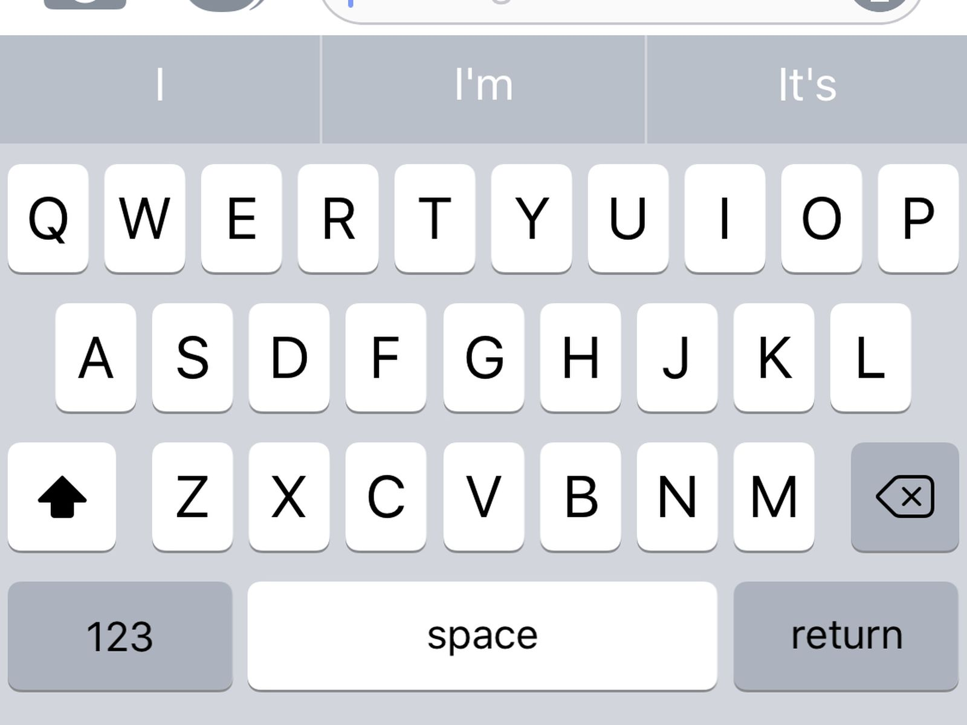
F
4. Search Screen
Search Bar
Current Location
Recent
Click the search bar to start typing!
Books Kinokuniya
McDonald
KFC
Waterfall
Shack Shake
Click the keyboard to start typing destination
LiHO!
B
Popular
More from recent history

Slide 69
F
Maybe you would like to search through voice as well? Click here to experience!
Books Kinokuniya
Search Result
4. Search Screen
Search Bar
Current Location
Books Kinokuniya
Recent
Wait for animation to finish (4s)…
Books Kinokuniya
Great! There is a search result! Click it to direct to the location!
McDonald
Click to start direction!
KFC
Waterfall
Shack Shake
LiHO!
B
Popular
More from recent history

Slide 70

F
Your Location
5. Direction Screen
Single-level Version
Popular Bookshop
L1
Popular
FairPrice
Single-level version of the direction screen will display if the destination is at the same level as the current user’s location.
Due to the limitation, this page does not have any clickable animation. Click here, or use the config menu to return back to the Search page.
Shack Shake
Waterfall
Starbucks
KFC
McDonald
F
Direction
Shortest
Less Walking
Wheelchair
19:05
10 meter · 5 min

Slide 71
F
Where to?
5. Direction Screen
Change Starting Location
Current Location
Click here to start navigation.
Recent
After user click the starting location in direction screen, the user will be redirect back to search screen.
User can change the starting location here, and the direction will be start at somewhere else.
We’ll pick current location as the starting location in this demo.
Books Kinokuniya
McDonald
KFC
Waterfall
Shack Shake
Let’s click current location to start the navigation.
LiHO!
Popular
More from recent history

Slide 72
Starting Location
(Default set to user’s current location)
F
Your Location
Swap Button
5. Direction Screen
Overview of features
Books Kinokuniya
Destination
L2
Books Kinokuniya
A&W
Toggle Level Button
Click any features to explore that certain features; or
Click anywhere else to follow the tutorial flow
Click to start introduction animation (6s)
Boost
Kopitiam
LiHO!
L1
Popular
FairPrice
Shack Shake
Waterfall
KFC
Starbucks
McDonald
F
Close Button
Direction
Filter Button
Shortest
Less Walking
Wheelchair
Ways of Travel Choices
19:05
Route Count Indicators
(Indicate how many direction is available)
Start Navigation Button
10 meter · 5 min

Slide 73
F
Search Bar
Return button
Where to?
Mic Button
4. Search Screen
Overview of features
Current Location
Recent
Current Location
Click any features to explore that certain features; or
Click anywhere else to follow the tutorial flow
Click to start introduction animation (2s)
Books Kinokuniya
McDonald
In the real application, all history record will be clickable.
KFC
In this demo, you can only click Books Kinokuniya or Popular for direction due to PowerPoint limitation.
Waterfall
Recent History
(Only 7 are shown)
Shack Shake
LiHO!
Popular
More from recent history
Click for more history

Slide 74
F
Your Location
5. Direction Screen
Swap Button
Books Kinokuniya
L2
Books Kinokuniya
A&W
Click the swap button to swap between starting location and destination!
Boost
Kopitiam
LiHO!
L1
Popular
FairPrice
Shack Shake
Waterfall
KFC
Starbucks
McDonald
F
Direction
Shortest
Less Walking
Wheelchair
19:05
10 meter · 5 min

Slide 75
F
Books Kinokuniya
5. Direction Screen
Swap Button
Your Location
L2
Books Kinokuniya
A&W
Click the swap button to swap between starting location and destination!
Boost
Kopitiam
LiHO!
L1
Popular
FairPrice
Shack Shake
Waterfall
KFC
Starbucks
McDonald
F
Direction
Shortest
Less Walking
Wheelchair
19:05
10 meter · 5 min

Slide 76
F
Your Location
5. Direction Screen
Swap Button
Books Kinokuniya
L2
Books Kinokuniya
A&W
Click the swap button to swap between starting location and destination!
Boost
Kopitiam
LiHO!
L1
Popular
FairPrice
Shack Shake
Waterfall
KFC
Starbucks
McDonald
F
Direction
Shortest
Less Walking
Wheelchair
19:05
10 meter · 5 min

Slide 77
F
Your Location
5. Direction Screen
Multi-level button
Books Kinokuniya
L2
Books Kinokuniya
A&W
Click the multi-level button to swap into single level view!
Boost
Kopitiam
LiHO!
L1
Popular
FairPrice
Shack Shake
Waterfall
KFC
Starbucks
McDonald
F
Direction
Shortest
Less Walking
Wheelchair
19:05
10 meter · 5 min

Slide 78
F
Your Location
Popular
Books Kinokuniya
FairPrice
5. Direction Screen
Multi-level button
L1
Click the multi-level button to swap into single level view!
L1
Shack Shake
Waterfall
Starbucks
KFC
McDonald
F
Direction
Shortest
Less Walking
Wheelchair
19:05
10 meter · 5 min

Slide 79
F
Your Location
5. Direction Screen
Multi-level button
Books Kinokuniya
L2
Books Kinokuniya
A&W
Click the multi-level button to swap into single level view!
Boost
Kopitiam
LiHO!
L1
Popular
FairPrice
Shack Shake
Waterfall
KFC
Starbucks
McDonald
F
Direction
Shortest
Less Walking
Wheelchair
19:05
10 meter · 5 min

Slide 80
F
Your Location
5. Direction Screen
Filter button
Books Kinokuniya
L2
Books Kinokuniya
A&W
Click the filter button to filter out mode of travel!
Boost
Kopitiam
LiHO!
L1
Popular
FairPrice
Shack Shake
Waterfall
KFC
Starbucks
McDonald
F
Direction
Shortest
Less Walking
Wheelchair
19:05
10 meter · 5 min

Slide 81
F
Your Location
5. Direction Screen
Filter button
Books Kinokuniya
L2
Books Kinokuniya
A&W
The user can filter out any mode of travel from here.
Boost
Let’s click the lift button to filter out lift from our mode of travel.
Kopitiam
LiHO!
L1
Popular
FairPrice
Shack Shake
Waterfall
KFC
Starbucks
McDonald
F
Filter
You can freely toggle the buttons
(all the changes, except for lift,
will be ignored in this demo)

Slide 82
F
Your Location
5. Direction Screen
Filter button
Books Kinokuniya
L2
Books Kinokuniya
A&W
Boost
The direction has updated based on the changes!
Kopitiam
LiHO!
L1
Popular
FairPrice
Shack Shake
Waterfall
KFC
Starbucks
McDonald
F
Filter
Let’s re-enable lift as our mode of travel by clicking it again

Slide 83
F
Your Location
5. Direction Screen
Filter button
Books Kinokuniya
L2
Books Kinokuniya
A&W
Boost
Kopitiam
LiHO!
L1
Popular
FairPrice
Shack Shake
Waterfall
KFC
Starbucks
McDonald
The direction has updated based on the changes!
F
Filter

Slide 84
F
Your Location
5. Direction Screen
Filter button
Books Kinokuniya
L2
Books Kinokuniya
A&W
Boost
Kopitiam
LiHO!
L1
Popular
FairPrice
Shack Shake
Waterfall
KFC
Starbucks
McDonald
F
Direction
Shortest
Less Walking
Wheelchair
19:05
10 meter · 5 min

Slide 85
F
Your Location
5. Direction Screen
Route Types Toggle
Books Kinokuniya
L2
Books Kinokuniya
A&W
Click the route type to toggle between different route types!
Boost
Kopitiam
LiHO!
L1
Popular
FairPrice
Shack Shake
Waterfall
KFC
Starbucks
McDonald
F
Direction
Shortest
Less Walking
Wheelchair
19:05
10 meter · 5 min

Slide 86
F
Your Location
5. Direction Screen
Route Types Toggle
Books Kinokuniya
L2
Books Kinokuniya
A&W
Click the route type to toggle between different route types!
Boost
Kopitiam
LiHO!
L1
Popular
FairPrice
Shack Shake
Waterfall
KFC
Starbucks
McDonald
F
Direction
Shortest
Less Walking
Wheelchair
19:05
10 meter · 5 min

Slide 87
F
Your Location
5. Direction Screen
Route Types Toggle
Books Kinokuniya
L2
Books Kinokuniya
A&W
Click the route type to toggle between different route types!
Boost
Kopitiam
LiHO!
L1
Popular
FairPrice
Shack Shake
Waterfall
KFC
Starbucks
McDonald
F
Direction
Shortest
Less Walking
Wheelchair
19:05
10 meter · 5 min

Slide 88
F
Your Location
5. Direction Screen
Route Types Toggle
Books Kinokuniya
L2
Books Kinokuniya
A&W
Click the route type to toggle between different route types!
Boost
Kopitiam
LiHO!
L1
Popular
FairPrice
Shack Shake
Waterfall
KFC
Starbucks
McDonald
F
Direction
Shortest
Less Walking
Wheelchair
19:05
10 meter · 5 min

Slide 89
F
Your Location
5. Direction Screen
Route Count Indicator
Books Kinokuniya
L2
Books Kinokuniya
A&W
These indicators show how many route that the user can choose from in that route types.
Boost
Kopitiam
Click the route type to toggle between different route!
LiHO!
L1
Popular
FairPrice
Shack Shake
Waterfall
KFC
Starbucks
McDonald
F
Direction
Shortest
Less Walking
Wheelchair
19:05
10 meter · 5 min

Slide 90
F
Your Location
5. Direction Screen
Route Count Indicator
Books Kinokuniya
L2
Books Kinokuniya
A&W
These indicators show how many route that the user can choose from in that route types.
Boost
Kopitiam
Click the route type to toggle between different route!
LiHO!
L1
Popular
FairPrice
Shack Shake
Waterfall
KFC
Starbucks
McDonald
F
Direction
Shortest
Less Walking
Wheelchair
19:05
10 meter · 5 min

Slide 91
F
Your Location
5. Direction Screen
Route Count Indicator
Books Kinokuniya
L2
Books Kinokuniya
A&W
These indicators show how many route that the user can choose from in that route types.
Boost
Kopitiam
Click the route type to toggle between different route!
LiHO!
L1
Popular
FairPrice
Shack Shake
Waterfall
KFC
Starbucks
McDonald
F
Direction
Shortest
Less Walking
Wheelchair
19:06
11 meter · 6 min

Slide 92
F
Your Location
5. Direction Screen
Route Count Indicator
Books Kinokuniya
L2
Books Kinokuniya
A&W
These indicators show how many route that the user can choose from in that route types.
Boost
Kopitiam
Click the route type to toggle between different route!
LiHO!
L1
Popular
FairPrice
Shack Shake
Waterfall
KFC
Starbucks
McDonald
F
Direction
Shortest
Less Walking
Wheelchair
19:08
12 meter · 8 min

Slide 93
F
Your Location
5. Direction Screen
Swap Button
Books Kinokuniya
L2
Books Kinokuniya
A&W
Finally, click the navigate button to start navigation!
Boost
Kopitiam
LiHO!
L1
Popular
FairPrice
Shack Shake
Waterfall
KFC
Starbucks
McDonald
F
Direction
Shortest
Less Walking
Wheelchair
19:05
10 meter · 5 min

Slide 94

Elevated Banner
Provide turn-by-turn navigation
F
3 m
Turn Right to Popular
Popular
FairPrice
6. Navigation Screen
Overview of features
L1
Click any features to explore that certain features; or
Click anywhere else to follow the tutorial flow
Click to start introduction animation (6s)
Shack Shake
Waterfall
Starbucks
KFC
McDonald
Sound Notification
F
19:05
300 meter · 5 min

Slide 95
F
3 m
Turn Right to Popular
Popular
FairPrice
6. Navigation Screen
Turn-by-turn Navigation
L1
The elevated banner provides turn-by-turn navigation to the user.
Shack Shake
Waterfall
The user can look into more detail for the navigation by:
1. Click the elevated banner, or
2. Scroll up the bottom sheet (by clicking the following gesture):
Starbucks
KFC
McDonald
Swipe Up
F
19:05
300 meter · 5 min

Slide 96
F
3 m
Turn Right to Popular
Popular
FairPrice
6. Navigation Screen
Turn-by-turn Navigation
F
19:05
L1
300 meter · 5 min
Now, more record is showing! There is more record below, lets scroll below to take a look!
Steps
Shack Shake
Turn Right to Popular
Waterfall
3 meter · 1 min
You can minimize the bottom sheet by scrolling down (by clicking the following gesture):
Starbucks
Go straight to Lift A
KFC
4 meter · 1 min
McDonald
Swipe Down
Take Lift to L2
2 min
Go straight to
Books Kinokuniya
3 meter · 1 min
Reach Books Kinokuniya

Slide 97
F
3 m
Turn Right to Popular
Popular
FairPrice
6. Navigation Screen
Turn-by-turn Navigation
L1
The elevated banner provides turn-by-turn navigation to the user.
Shack Shake
Waterfall
The user can look into more detail for the navigation by:
1. Click the elevated banner, or
2. Scroll up the bottom sheet (by clicking the following gesture):
Starbucks
KFC
McDonald
Swipe Up
F
19:05
300 meter · 5 min

Slide 98
F
3 m
Turn Right to Popular
Popular
FairPrice
6. Navigation Screen
Sound Notification
L1
Click the sound button to mute / unmute sound notification!
Shack Shake
Waterfall
Starbucks
KFC
McDonald
F
19:05
300 meter · 5 min

Slide 99

F
3 m
Turn Right to Popular
Popular
FairPrice
6. Navigation Screen
Sound Notification
L1
Click the sound button to mute / unmute sound notification!
Shack Shake
Waterfall
Starbucks
KFC
McDonald
F
19:05
300 meter · 5 min

Slide 100
F
3 m
Turn Right to Popular
Popular
FairPrice
6. Navigation Screen
Sound Notification
L1
Click the sound button to mute / unmute sound notification!
Shack Shake
Waterfall
Starbucks
KFC
McDonald
F
19:05
300 meter · 5 min

Slide 101

Popular
FairPrice
Closing Sequence
Using Drawer View
L1
Click drawer button to call out the drawer!
Shack Shake
Waterfall
Starbucks
KFC
McDonald
F
Where to?

Slide 102
Popular
FairPrice
Closing Sequence
Using Drawer View
L1
Click drawer button to call out the drawer!
Shack Shake
Waterfall
Starbucks
KFC
McDonald
F
Where to?

Slide 103

Menu
Popular
FairPrice
Closing Sequence
Using Drawer View
Language
English
L1
Click shut down to close the application.
Font Size
Shack Shake
A
A
Waterfall
Exit
application?
Dark Mode
Starbucks
KFC
Cancel
OK
UI Alignment
McDonald
Left
Right
FAQ / Guide
Shut Down
F
Where to?

Slide 104


Closing Sequence
Using Drawer View
Thank you for using
NTUNavigate
AN INDOOR NAVIGATION SYSTEM

Slide 105
Reference
Cursor: https://en.m.wikipedia.org/wiki/File:Text_cursor_blinking.gif
Various Icons: https://fonts.google.com/icons

Slide 106
Go back to overview?
Yes
No, Exit Instead

